Slide 1

Title - Electviz Election Data Visualization For Media
Name-Oshin Paul
Date-30/10/25

Slide 2
INTRODUCTION
ElectViz – Election Data Visualisation for Media is a data-driven analytics project designed to simplify election information using interactive and visually rich dashboards.
This project leverages Power BI to transform election data into intuitive charts, maps, and graphs, enabling media professionals, analysts, and the public to understand election outcomes at a glance. ElectViz helps users compare party performances across regions, analyze vote shares, study turnout variations, and track historical election patterns. By presenting election insights in a visually compelling manner, ElectViz enhances clarity, supports real-time analysis, and improves the effectiveness of news reporting and electoral decision-making.

Slide 3
Objectives
Convert raw election data into meaningful visual insights using interactive dashboards and charts.
Support media platforms in real-time election reporting with clear, fast, and accurate data representation.
Analyze party performance and vote share trends across different regions and constituencies.
Provide comparative analysis between current and past election results for trend identification.
Improve public understanding of election outcomes through intuitive visualizations like maps, bar charts, and KPI cards.
Enable deep insights into voter demographics and turnout patterns for better political analysis.
Ensure data accuracy and reliability by using authenticated and structured data sources.
Offer customizable dashboards suitable for media studios, digital news platforms, and social media presentations.

Slide 4
Problem Statement
Elections generate massive volumes of complex data including votes, constituencies, party performance, turnout ratios, and demographic patterns. Traditional reporting methods often struggle to present this information in a clear and timely manner, leading to information overload and difficulty in understanding real election trends. Media platforms require fast, accurate, and visually intuitive tools to analyze and communicate election results to the public. However, the lack of real-time, interactive, and easy-to-interpret visual dashboards creates challenges in delivering meaningful insights and engaging viewer experiences.
ElectViz – Election Data Visualisation for Media aims to solve this problem by transforming raw election data into dynamic, interactive Power BI dashboards that enable seamless analysis, real-time reporting, and visually appealing presentation for media houses, analysts, and the public.

Slide 5
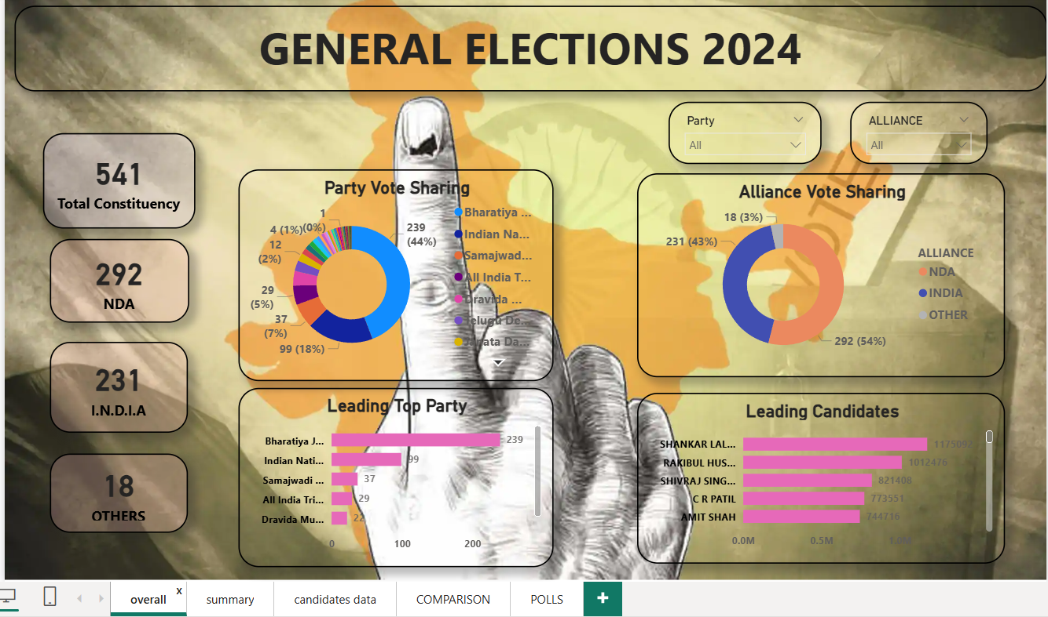
Dashboard Snapshots (This helps in understanding the national results)

Slide 6
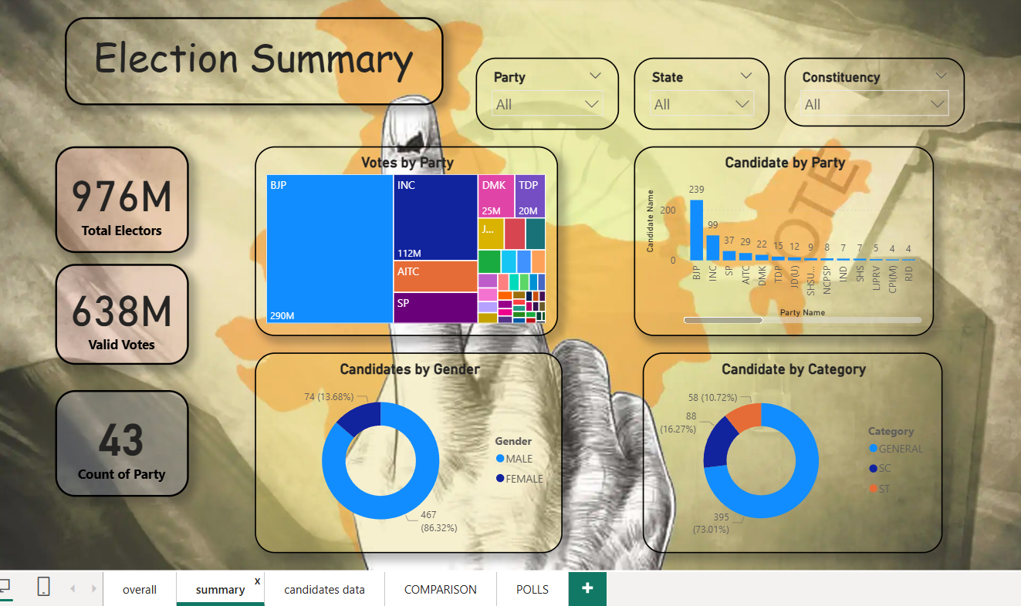
ELECTION SUMMARY

Slide 7
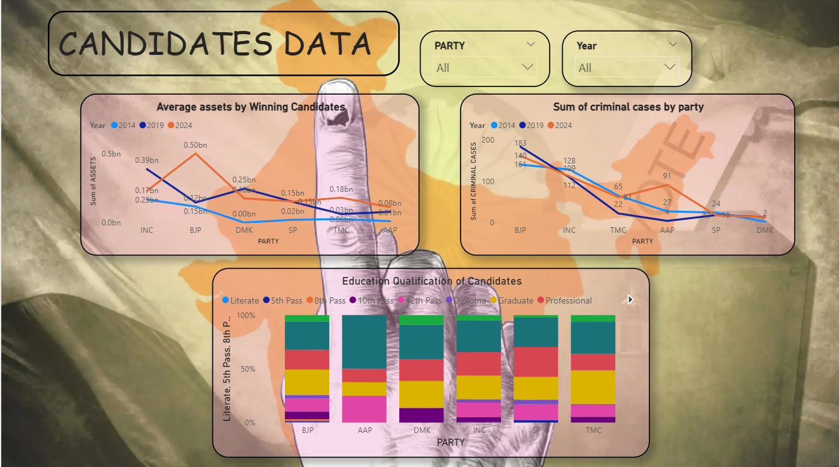
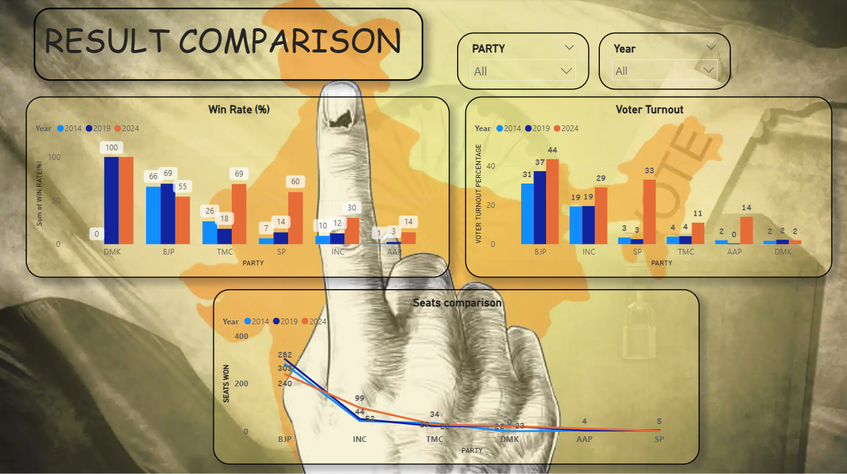
CANDIDATES DATA
RESULT COMPARISON
(party & year)

Slide 8
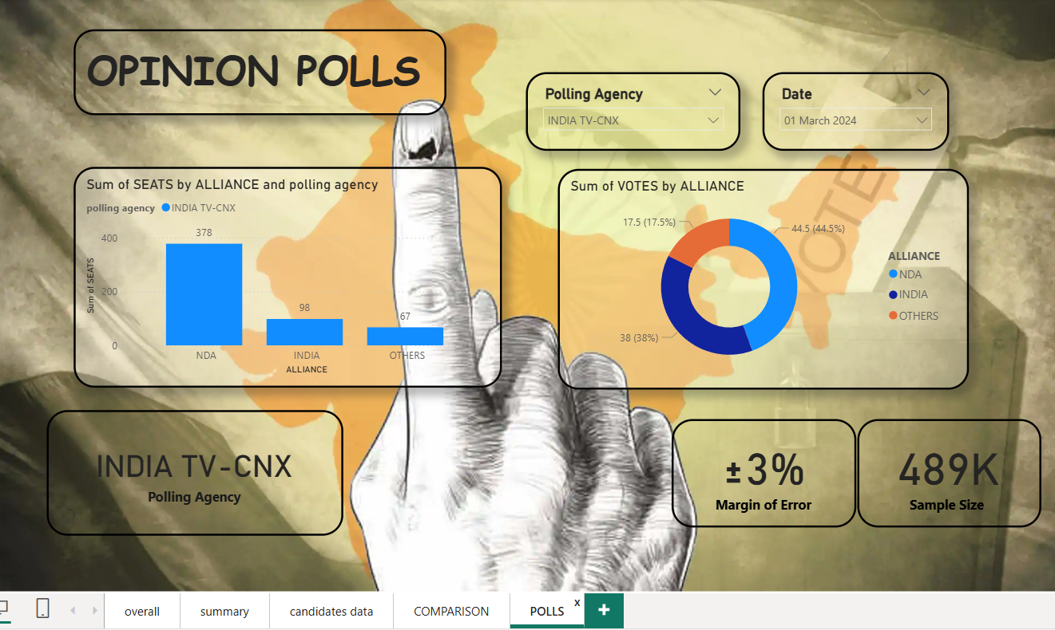
Pre-Election Opinion Polls (This shows public perception before results)

Slide 9
Insights &Findings
NDA is projected to lead the election with the highest seats and vote share.
INDIA alliance follows at a distant second, while Other parties hold a smaller but notable share.
Poll data is based on INDIA TV–CNX survey with a large sample size (~489K) and ±3% margin of error, making the results statistically credible.
Dashboard shows clear comparison of seats and votes, with filters for polling agency and date to analyze trends quickly.
Overall, the poll indicates a strong advantage for NDA, but results may vary slightly due to survey margin of error.

Slide 10
Future Scope & Features
multilingual visualization
Interactive Dashboards to explore election data with dynamic charts and maps.
Date & Filter Controls
Opinion Poll & Exit Poll Views
Integrate real-time live election results using API connectivity for instant updates.
Include AI-based prediction Opinion Poll & Exit Poll Views to study pre-election and post-poll trends.models to forecast seat outcomes, voter swings, and turnout trends.
Add sentiment analysis from social media to understand public opinion alongside poll numbers.
Expand dashboards for state elections, local bodies, and historical election trends.

Slide 11
Conclusion
ElectViz successfully transforms complex election data into clear, interactive, and meaningful visual insights. By providing alliance-wise seat projections, vote share comparisons, polling agency filters, and opinion poll analytics, the dashboard enables media organizations, analysts, and viewers to understand election trends quickly and accurately. This project demonstrates the role of data visualization in transparent and informed political reporting, helping audiences make sense of large-scale electoral data. With future enhancements such as real-time updates, AI-based predictions, and social sentiment integration, ElectViz has strong potential to evolve into a comprehensive election analytics platform for digital media and public decision-making.

Slide 12
THANKYOU

